Slide 1
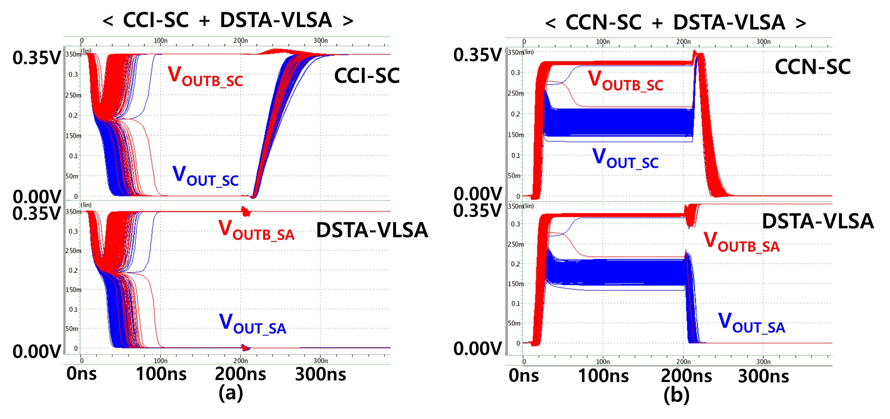
Study on Cross-Coupled-Based Sensing Circuits for Nonvolatile Flip-Flops Operating in Near/Subthreshold Voltage Region
Bayartulga Ishdorj and Taehui Na
Department of Electronics Engineering, Incheon National University, Incheon 22012, South Korea
The nonvolatile flip-flop (NV-FF) is regarded as a potential substitute for the conventional volatile FF because of advantages such as zero standby power consumption in the standby mode (power saving), instant-ON from power-down conditions (user-experience improvement and power saving), instant-OFF to the standby mode (power-saving and nonrequirement of external NV memory), and prevention of sudden power failure (reliability improvement).
Among the various NV-FF implementations, spin-transfer-torque magnetic tunnel junction (STT-MTJ)-based NV-FFs are considered promising due to their characteristics, including nonvolatility, high endurance, long retention time, CMOS compatibility, scalability, and nil area overhead because of stacking above a MOS transistor.
Recently, it was suggested that offset-cancellation sensing-circuit-based NV-FFs are insensitive to the offset voltage caused by process variation, improving the restore yield. However, these NV-FFs are only valid in the super-threshold voltage region. And are very sensitive to process variations in the near/subthreshold voltage region, because multiple switches for offset-cancellation (Fig. 1.) operation become significant contributors to the offset voltage.
Introduction
Circuit schematics
Results and Discussion
Fig. 3 Simulated restore yield of the state-of-the-art NV-FFs according to V_{DD}. (a) Typical V_{th} devices are used for PT, NL, NR, and NB. (b) Extremely large devices (10 times larger than the condition in Figure (a)) and low-V_{th} devices are used for all the transistors.
Fig. 2. (a) Cross-coupled Inverter (CCI) based Sensing Circuit. (b) Proposed Cross-Coupled-NMOS(CCN) based Sensing-Circuit.
The CCN-SC reduces the number of transistors critical for determining restore yield compared to CCI-SC.
Fig. 1. Circuit diagram of state-of-the-art NV-FFs. (a) Song’s NV-FF. (b) Na’s NV-FF.
Fig. 4. Simulated transient responses. (a) CCI-SC + DSTA-VLSA. (b) CCN-SC + DSTA-VLSA. The CCN-SC has a higher restore yield than the CCI-SC.
Test chip
Results and Discussion
Fig. 5. The die photo and structure of the test chip implemented using 65 nm CMOS technology. The structure includes nine 8×8 CCI-SC arrays and 8×8 CCN-SC arrays, each, with different sizes and resistances for yield testing.
Fig. 6. Simulated restore yield according to the critical transistor width (a) When the R_{MTJB} – R_{MTJA} = 3kΩ. (b) When R_{MTJB} – R_{MTJA} = 1kΩ. When the resistance difference decreases considering MTJ variation the restore yield of CCI-SC decreases drastically. This is because, in the CCN-SC, only the NL/NR Vth mismatch degrades the restore yield, in contrast, the PL/PR Vth mismatch is added in case of CCI-SC. Also, because of the lower IR drop from V_{DD} to ground in the CCN-SC the effective V_{DD} is higher.
Table 1: Restore yield and restore failure according to width of the critical transistor when resistance difference value of 1kΩ is assumed.
In is study, we investigated two cross-coupled-based sensing circuits for an NV-FF operating in the near/subthreshold voltage region (<0.4 V): a popular cross-coupled inverter-based sensing circuit (CCI-SC), and the proposed cross-coupled NMOS-based sensing circuit (CCN-SC).
We demonstrate that the CCN-SC achieves better restore yield in the near/subthreshold voltage region on the notion that the simplest is the best.
Conclusion

